Slide 1
Secure Data Hiding in Image Using Steganography
CAPSTONE PROJECT
Presented By:
Student Name : Anmol Singh Rawat
College Name & Department : Graphic Era Deemed to be University, B.Tech CSE

Slide 2
OUTLINE
Problem Statement
Technology used
Wow factor
End users
Result
Conclusion
Git-hub Link
Future scope

Slide 3
Problem Statement
Steganography is the practice of hiding information within digital media, such as images, without altering the medium's noticeable properties. While traditional steganography techniques are effective in concealing messages, they can be vulnerable to detection.
This project addresses these limitations by directly embedding messages into pixel values using a custom encryption method. The encryption encodes the message within the image pixels while preserving the visual integrity of the image. A passcode-based authentication mechanism ensures that only authorized users can extract the hidden message.
The goal is to provide a secure and user-friendly solution for hiding sensitive information within images without noticeable modifications.

Slide 4
Technology used
Programming Language: Python (for implementing embedding and extraction logic)
Libraries:
OpenCV: Image processing and manipulation
NumPy: Efficient data handling for image modifications
Steganography Technique:
Message length stored in the first few pixels
Message encoded within the image pixels
Passcode authentication for decryption
Platform: Runs on any Python environment (including local systems and Google Colab)

Slide 5
Wow factors
Enhanced Security: A passcode-based authentication ensures that only authorized users can decrypt messages.
Custom Embedding Approach: The project does not rely on standard steganographic techniques, making detection harder.
User-Friendly Implementation: The encryption and decryption scripts are simple to use, making it accessible for various users.
Invisible Embedding: The hidden message does not alter the image’s noticeable properties, ensuring secrecy.
Cross-Platform Compatibility: Can run on any Python-supported system, including cloud platforms like Google Colab.

Slide 6
End users
Cybersecurity Professionals: For secure data transmission over public networks.
Students and Educators: To learn about steganography and cryptography.
Journalists and Whistleblowers: For safely sharing confidential information.
Software Developers: As a reference for advanced security applications.
General Users: For embedding and sharing secret messages within images.

Slide 7
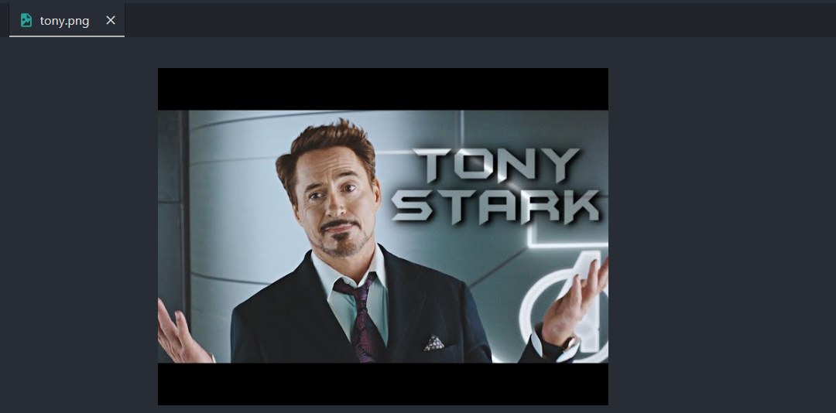
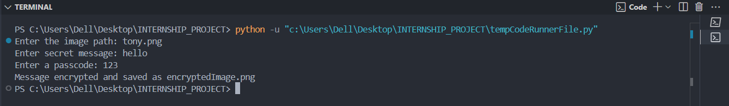
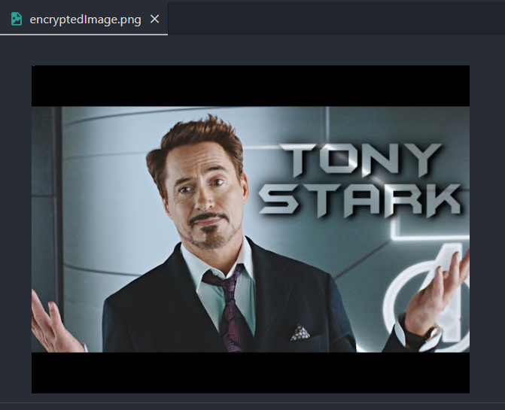
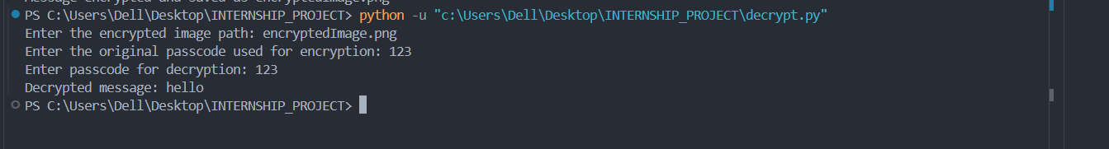
Results
Example 1:
tony.png
encryptedImage.png

Slide 8
Conclusion
This project successfully demonstrates a secure and efficient method for embedding messages in images. By directly encoding message data into pixel values and using a passcode-based authentication mechanism, the project ensures that sensitive information remains protected.
The implementation using Python and OpenCV provides a scalable and efficient platform for this approach. The technique can be further enhanced by integrating more robust encryption methods and automation features.

Slide 9
GitHub Link
The complete code and detailed instructions for this project are available on GitHub: https://github.com/anmolsinghrawat/Steganography

Slide 10
Future scope(optional)
Support for Additional File Types: Expanding the project to embed and extract messages in other media formats such as audio and video.
Advanced Encryption: Integrating more robust encryption algorithms like AES or RSA to enhance security further.
Automated Key Management: Implementing a mechanism to securely generate, share, and store encryption keys for easier access and enhanced usability.
GUI Integration: Developing a graphical user interface (GUI) to make the tool more user-friendly for non-technical users.

Slide 11
THANK YOU

